Slide 1


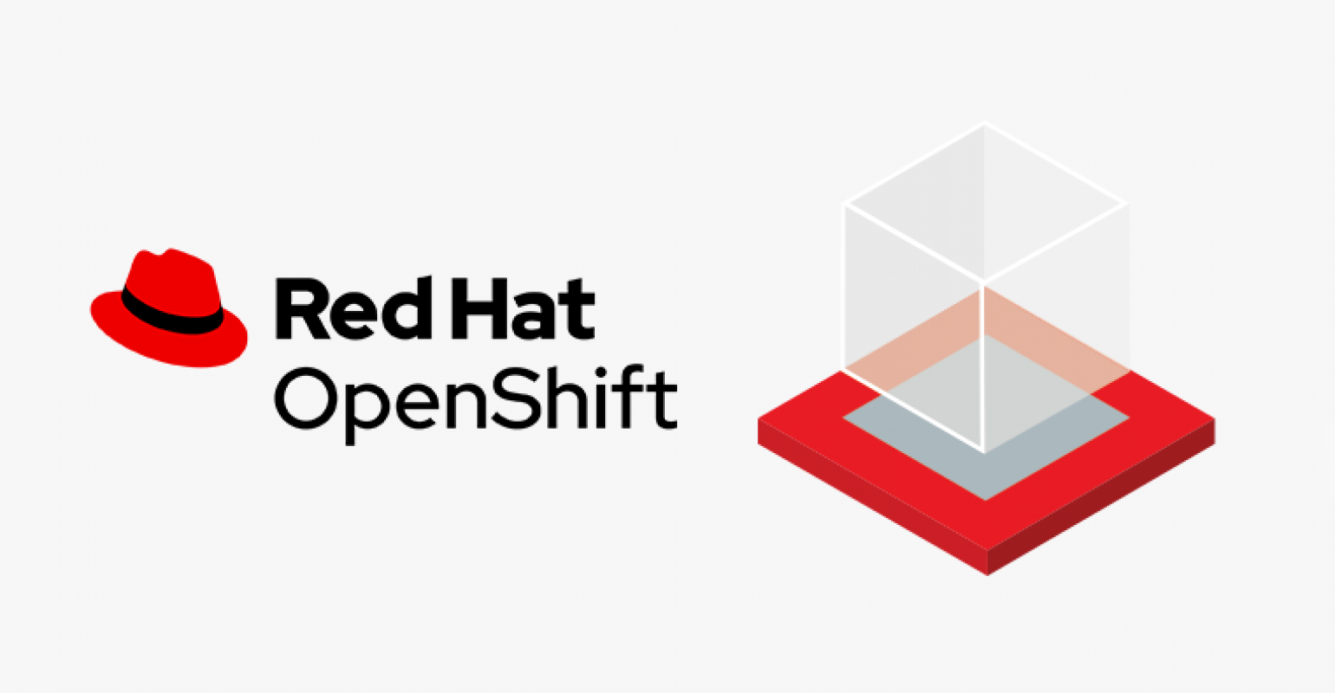

Slide 2
Routes and Templates
Routes
In OpenShift, routing is a method of exposing the service to the external world by creating and configuring externally reachable hostname.
Routes and endpoints are used to expose the service to the external world, from where the user can use the name connectivity (DNS) to access defined application.
In OpenShift, routes are created by using routers which are deployed by OpenShift admin on the cluster. Routers are used to bind HTTP (80) and https (443) ports to external applications.
Following are the different kinds of protocol supported by routes:
• HTTP
• HTTPS
• TSL and web socket

Slide 3
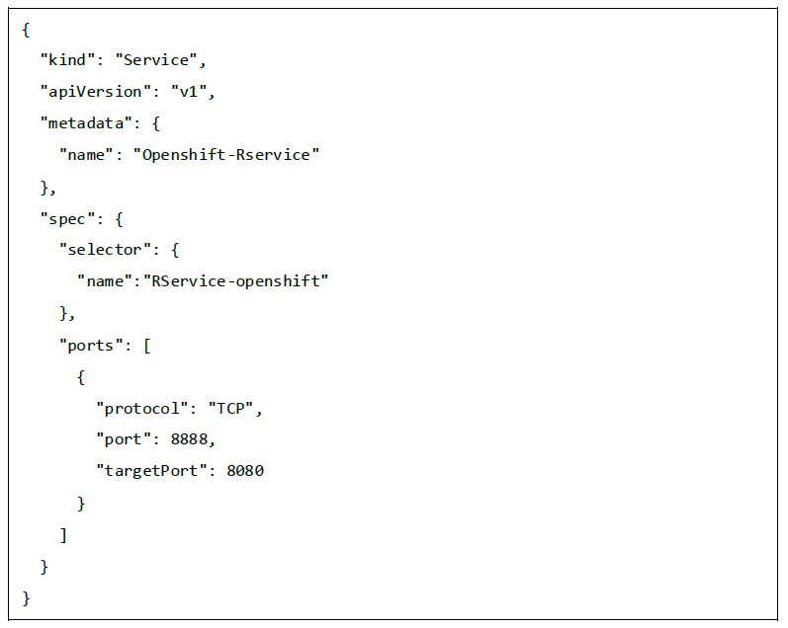
When configuring the service, selectors are used to configure the service and find the endpoint using that service.
Following is an example of how we create a service and the routing for that service by using an appropriate protocol.

Slide 4
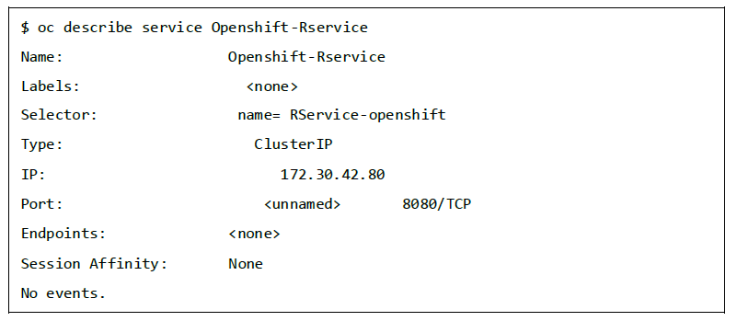
Next, run the following command and the service is created.
$ oc create -f ~/training/content/Openshift-Rservice.json
This is how the service looks like after creation.

Slide 5
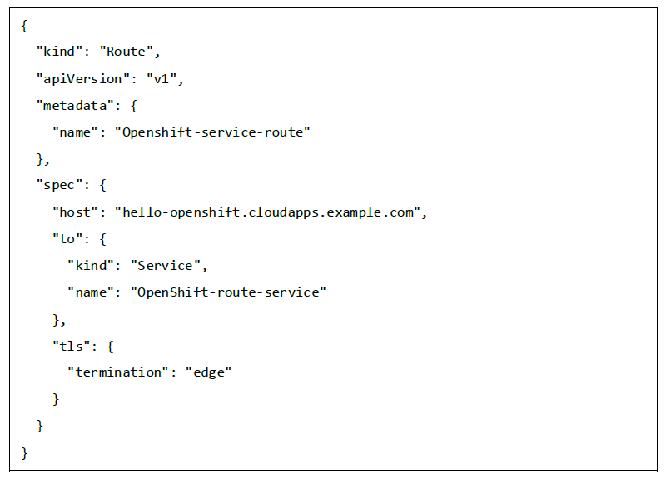
Create a routing for service using the following code.
When OC command is used to create a route, a new instance of route resource is created.

Slide 6
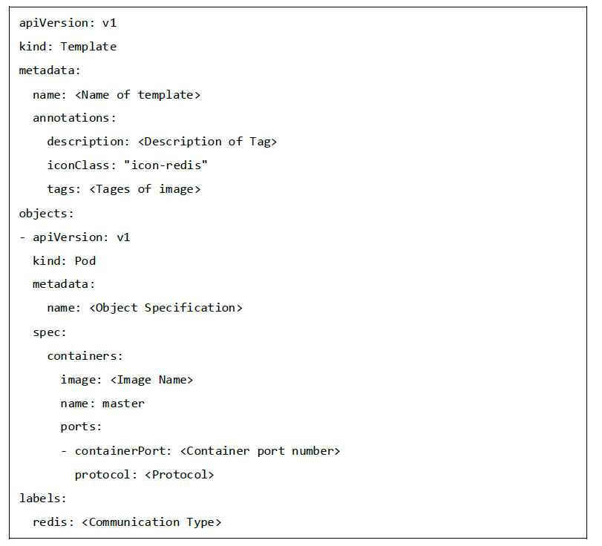
Templates
Templates are defined as a standard object in OpenShift which can be used multiple times.
It is parameterized with a list of placeholders which are used to create multiple objects.
This can be used to create anything, starting from a pod to networking, for which users have authorization to create.
A list of objects can be created, if the template from CLI or GUI interface in the image is uploaded to the project directory.

Slide 7
Authentication and Authorization
Authentication
In OpenShift, while configuring master and client structure, master comes up with an inbuilt feature of OAuth server.
OAuth server is used for generating tokens, which is used for authentication to the API. Since, OAuth comes as a default setup for master, we have the Allow All identity provider used by default.
Different identity providers are present which can be configured at /etc/openshift/master/master-config.yaml.
There are different types of identity providers present in OAuth.
• Allow All
• Deny All
• HTPasswd
• LDAP
• Basic Authentication

Slide 8
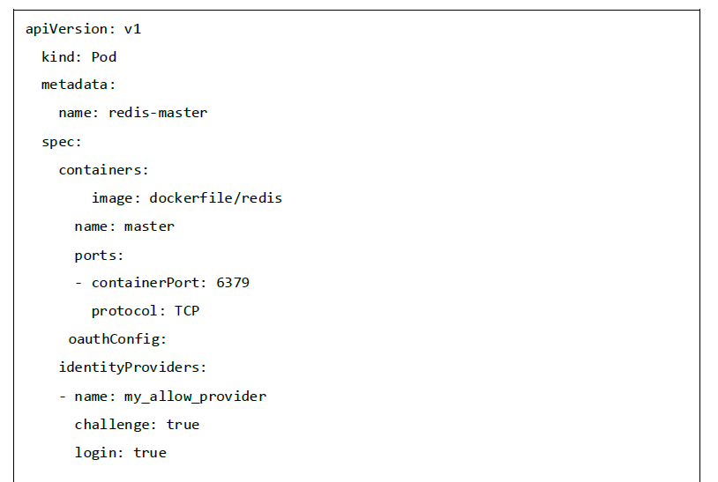
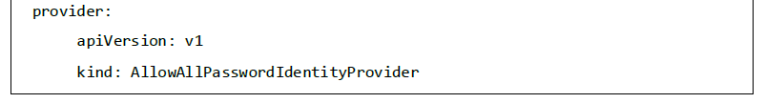
Allow All

Slide 9
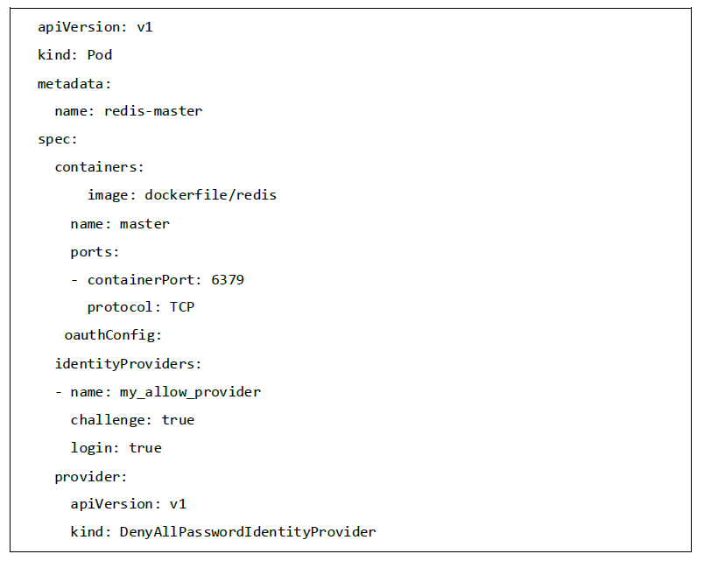
Deny All

Slide 10
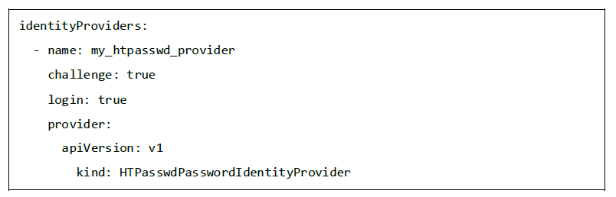
HTPasswd
In order to use HTPasswd, we need to first set up Httpd-tools on the master machine and then configure it in the same way as we did for others.

Slide 11
Authorization
Authorization is a feature of OpenShift master, which is used to validate for validating a user.
This means that it checks the user who is trying to perform an action to see if the user is authorized to perform that action on a given project.
This helps the administrator to control access on the projects.
Authorization policies are controlled using -
• Rules
• Roles
• Bindings
Evaluation of authorization is done using -
• Identity
• Action
• Bindings
Using Policies -
• Cluster policy
• Local policy

Slide 12
Creating a New Application
In OpenShift, there are three methods of creating a new application.
• From a source code
• From an image
• From a template
From a Source Code
When we try to create an application from the source code, OpenShift looks for a Docker file that should be present inside the repo, which defines the application build flow. We will use oc new-app to create an application.
First thing to keep in mind while using a repo is that, it should point to a origin in the repo from where OpenShift will pull the code and build it.

Slide 13
If the repo is cloned on the Docker machine where OC client is installed and the user is inside the same directory, then it can be created using the following command.
$ oc new-app . <Hear. Denotes current working directory>
Following is an example of trying to build from remote repo for a specific branch.
$ oc new-app https://github.com/openshift/Testing-deployment.git#test1
Here, test1 is the branch from where we are trying to create a new application in OpenShift.
When specifying a Docker file in the repository, we need to define the build strategy as shown below.
$ oc new-app OpenShift/OpenShift-test~https://github.com/openshift/Testing-deployment.git

Slide 14
From an Image
While building an application using images, the images are present in the local Docker server, in the in-house hosted Docker repository, or on the Docker hub.
The only thing that a user needs to make sure is, he has the access to pull images from the hub without any issue.
OpenShift has the capability to determine the source used, whether it is a Docker image or a source stream.
However, if the user wishes he can explicitly define whether it is an image stream or a Docker image.
$ oc new-app - - docker-image tomcat
Using an image stream –
$ oc new-app tomcat:v1

Slide 15
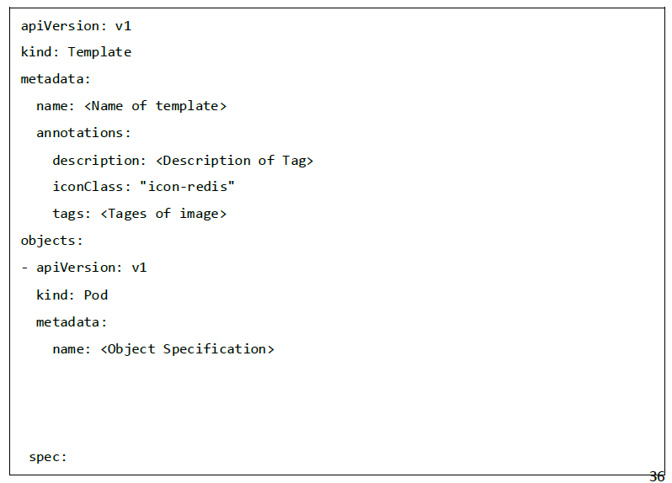
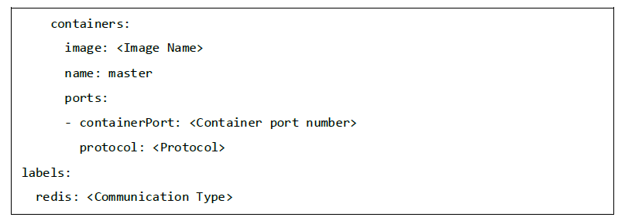
From a Template
Templates can be used for the creation of a new application. It can be an already existing template or creating a new template.
Following yaml file is basically a template that can be used for deployment.

Slide 16
Develop and Deploy a Web Application
Developing a New Application in OpenShift
In order to create a new application in OpenShift, we have to write a new application code and build it using OpenShift OC build commands.
As discussed, we have multiple ways of creating a new image. Here, we will be using a template to build the application.
This template will build a new application when run with oc new-app command.
The following template will create: Two front-end applications and one database.
Along with that, it will create two new services and those applications will get deployed to OpenShift cluster.
While building and deploying an application, initially we need to create a namespace in OpenShift and deploy the application under that namespace.

Slide 17
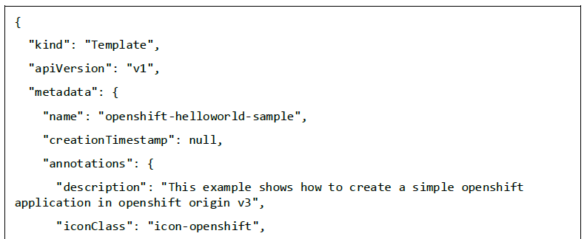
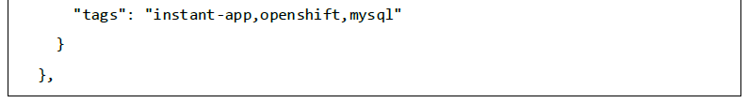
Create a new namespace
$ oc new-project openshift-test --display-name="OpenShift 3 Sample" --description="This is an example project to demonstrate OpenShift v3"
Template

Slide 18
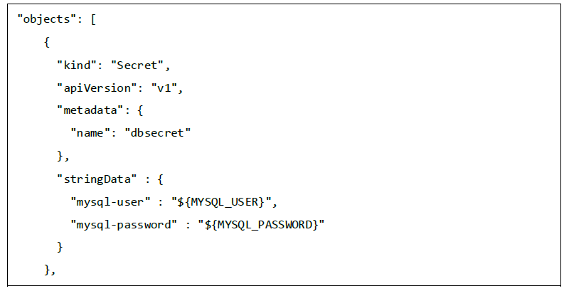
Object Definitions
Secret definition in a template

Slide 19
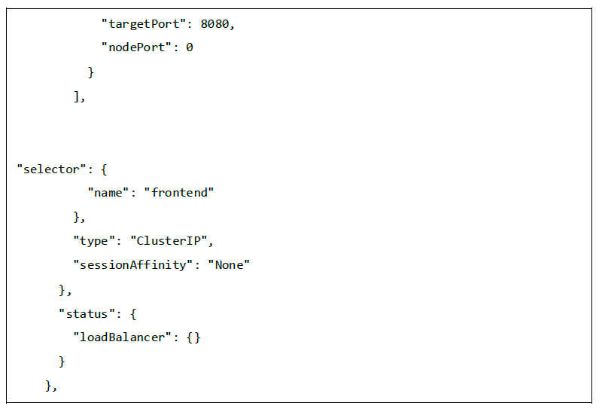
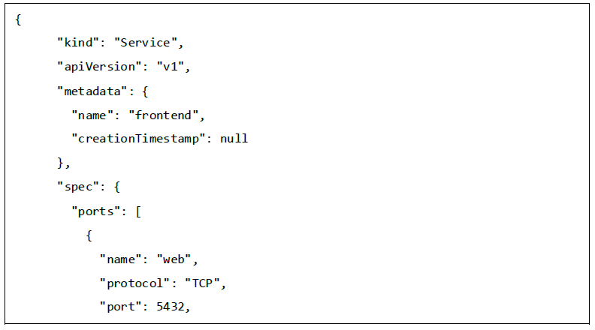
Service definition in a template

Slide 20
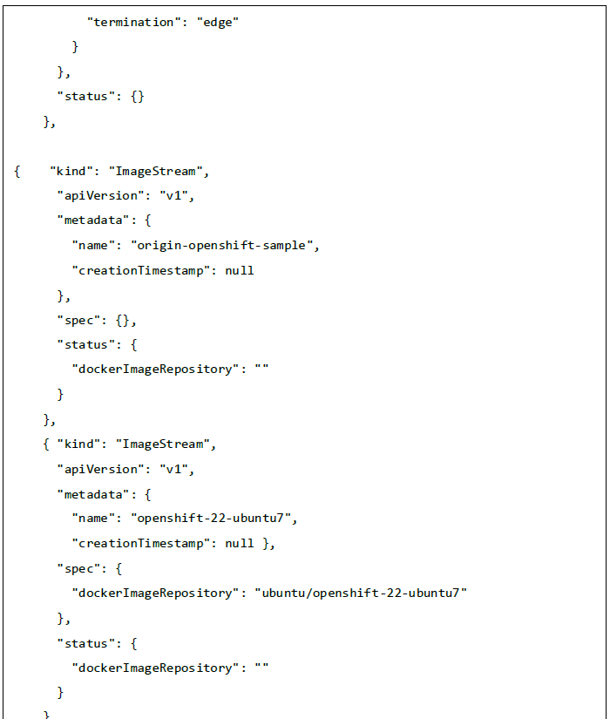
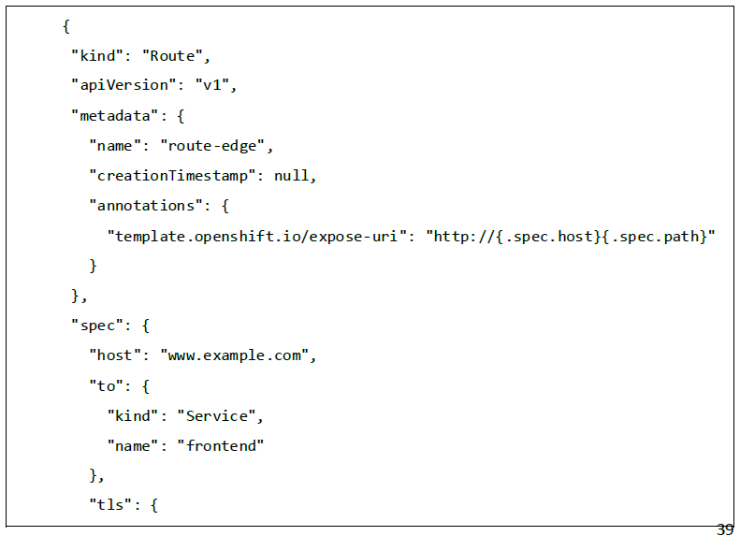
Route definition in a template

Slide 21
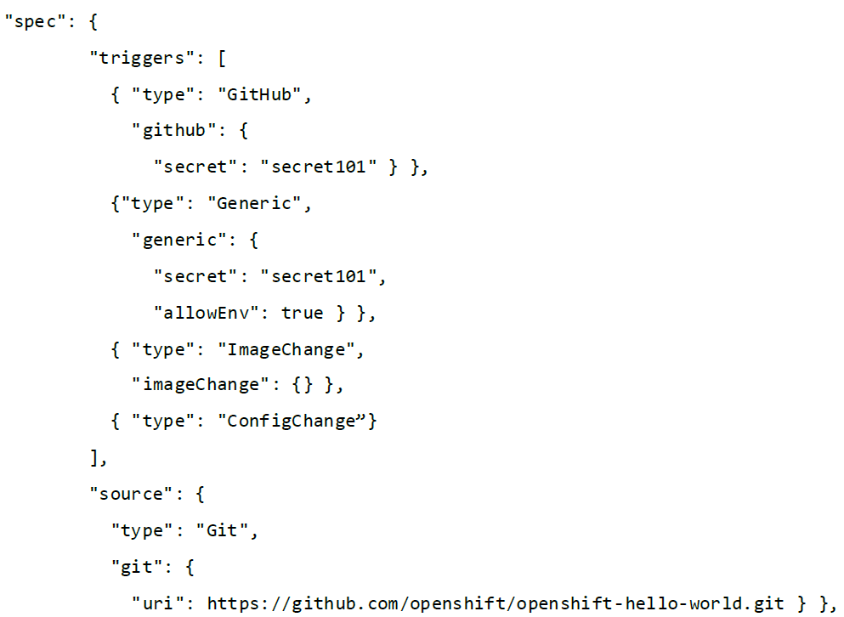
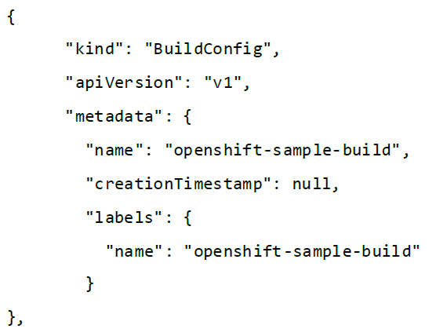
Build config definition in a Template

Slide 22
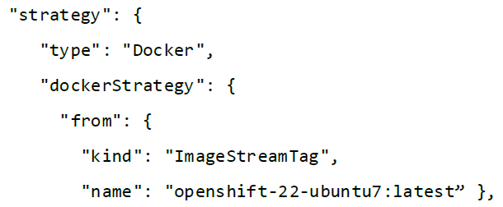


Slide 23
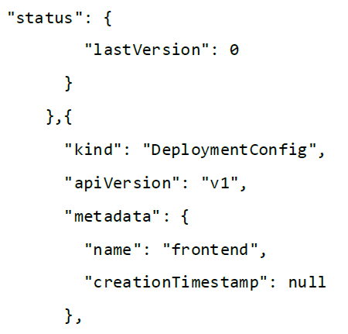
Deployment config in a Template

Slide 26
Service Definition in a Template

Slide 27
Deployment config definition in a Template

Slide 31
The template file from before needs to be compiled at once.
We need to first copy all the content into a single file and name it as a yaml file once done.
We need to run the following command to create the application.

Slide 36
BuildConfig FileIn
OpenShift,BuildConfig is a rest object used to connect to API and then create a new instance.

Slide 37
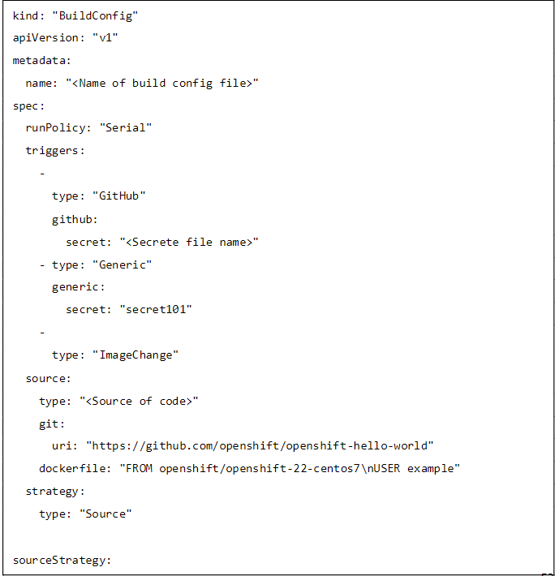
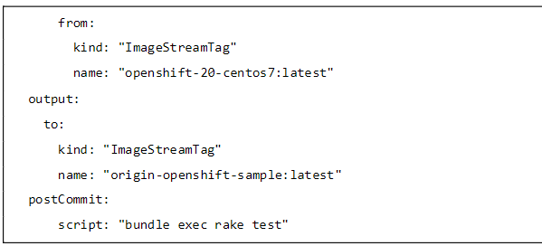

Slide 38
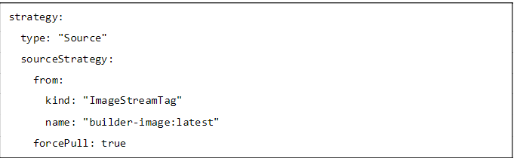
Source-to-image Strategy
Allows creating container images starting from the source code. In this flow,the actual code gets downloaded first in the container and then gets compiled inside it.
There are multiple strategy policies:
Forcepull
Incremental Builds
External Builds

Slide 39
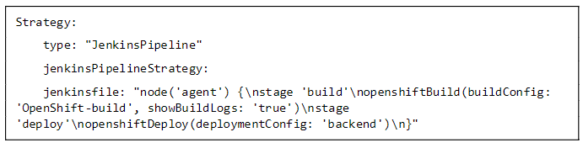
Pipeline Strategy
This build flow uses custom build pipeline flow using Groovy DSL language. OpenShift will create a pipeline job in Jenkins and execute it.
This pipeline flow can also be used in Jenkins. In this strategy,we use Jenkinsfile and append that in the buildconfig definition.

Slide 40
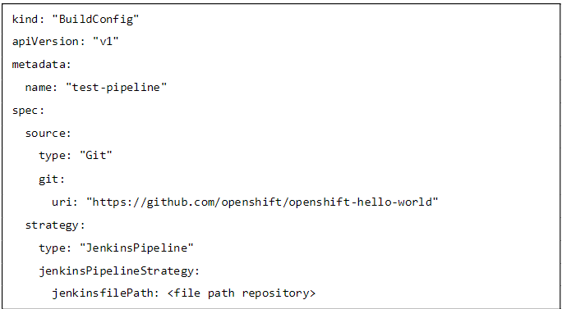
Using build pipeline

Slide 41
OpenShift-CLI
OpenShift CLI Setup
In order to setup the OC client on a different operating system, we need to go through different sequence of steps.
OC Client for Windows
Step 1:Download the OC CLI from the following link https://github.com/openshift/origin/releases/tag/v3.6.0-alpha.2
Step 2:Unzip the package on a target path on the machine.
Step 3:Edit the path environment variable of the system.

Slide 42
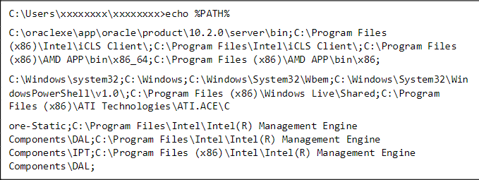
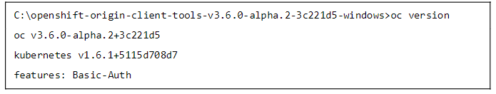

Slide 43


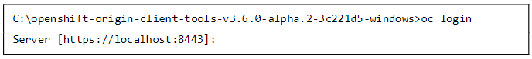
OC Client for Mac OS X
We can download the Mac OS setup binaries for the same location as for Windows and later unzip it at a location and set a path of executable under the environment PATH variable
Alternative:
OC Client for Linux
We have the tar file for Linux installation that can be used for installation. Later, a path variable can be set pointing to that particular executable location.

Slide 44
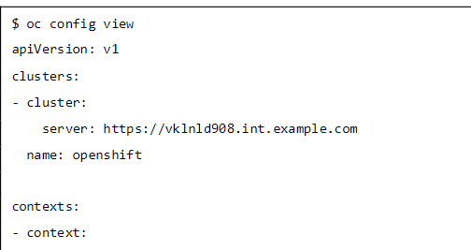
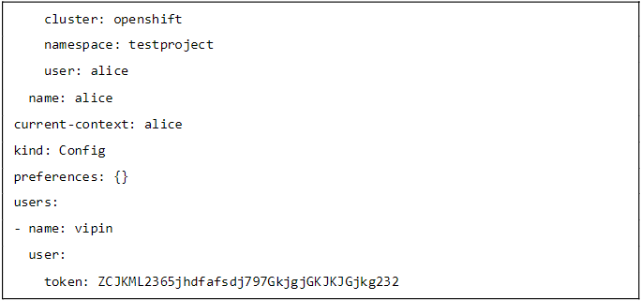
CLI Configuration Files
This configuration file is used for storing and managing multiple profiles and for switching between them. A normal configuration file looks like the following.

Slide 45
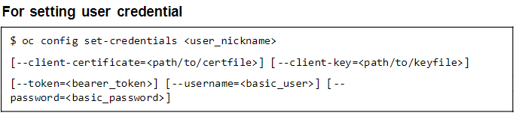
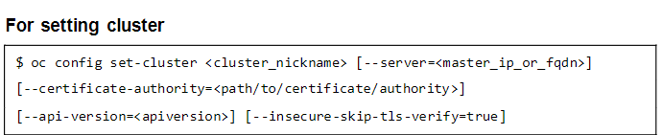
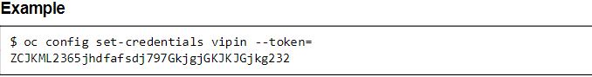
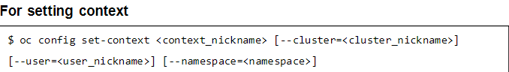
Setting Up CLI Client

Slide 46
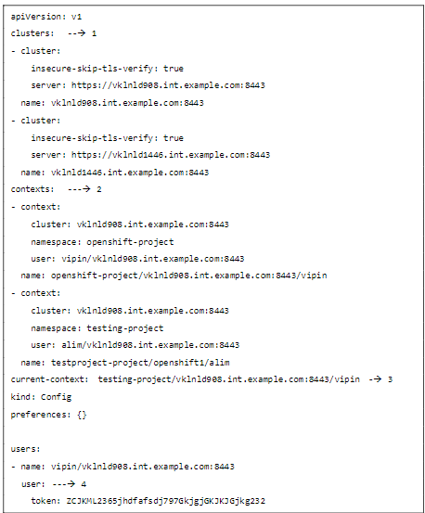
CLI Profiles

Slide 47
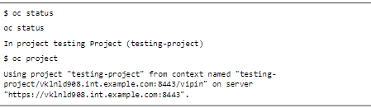
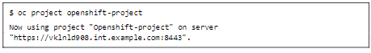

Slide 48
OpenShift – CLI Operations
OpenShift CLI is capable of performing all basic and advance configuration, management , addition, and deployment of applications.
We can perform different kinds of operations using OC commands. This client helps you develop, build, deploy, and run your applications on any OpenShift or Kubernetes compatible platform.
It also includes the administrative commands for managing a cluster under the 'adm' subcommand.

Slide 49
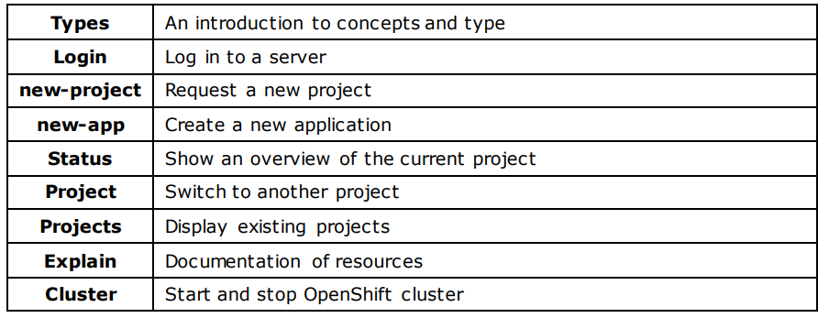
Basic Commands

Slide 50
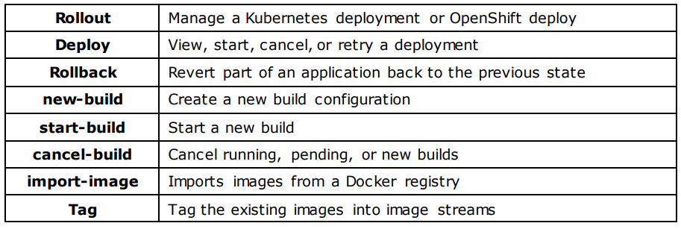
Build and Deploy Commands

Slide 51
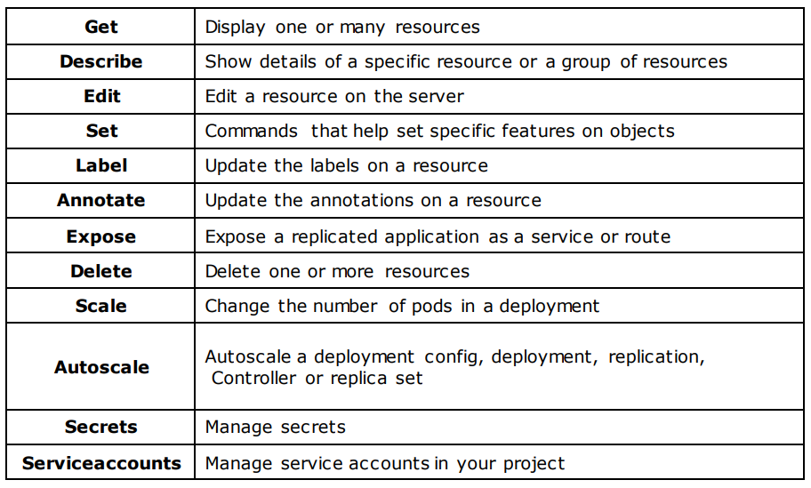
Application Management Commands

Slide 52
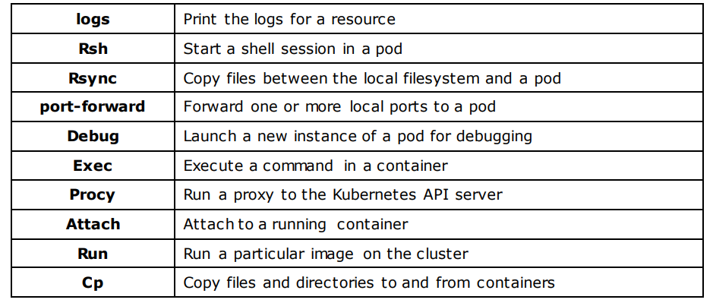
Troubleshooting and Debugging Commands

Slide 53
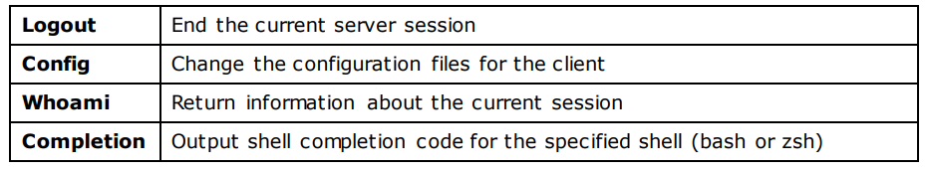
Setting Commands

Slide 54

OpenShift – Clusters
OpenShift uses two installation methods of setting up OpenShift cluster.
Quick installation method
Advanced configuration method
Setting Up Cluster
Quick Installation Method
This method is used for running a quick unattained cluster setup configuration. In order to use this method, we need to first install the installer. This can be done by running the following command

Slide 55

Advanced Installation
Advanced installation is completely based on Ansible configuration wherein the complete host configuration and variables definition regarding master and node configuration is present. This contains all the details regarding the configuration. Once we have the setup and the playbook is ready, we can simply run the following command to setup the cluster.

Slide 56
Managing Cluster Logs
OpenShift cluster log is nothing but the logs which are getting generated from the master and the node machines of cluster. These can manage any kind of log, starting from server log, master log, container log, pod log, etc . There are multiple technologies and applications present for container log management.
Few of the tools are as listed, which can be implemented for log management.
Fluentd
ELK
Kabna
Nagios
Splunk

Slide 57
Upgrading a Cluster
Upgradation of the cluster involves upgrading multiple things within the cluster and getting the cluster updated with new components and upgrades. This involves –
Upgradation of master components
Upgradation of node components
Upgradation of policies
Upgradation of routes
Upgradation of image stream
In order to perform all these upgrades, we need to first get quick installers or utils in place.

Slide 58
THANK
YOU

